Slide 1
WG3

Slide 2

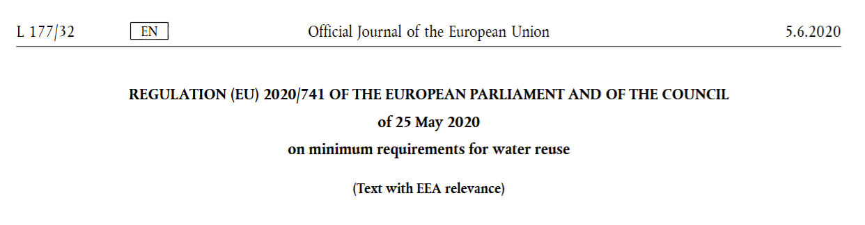
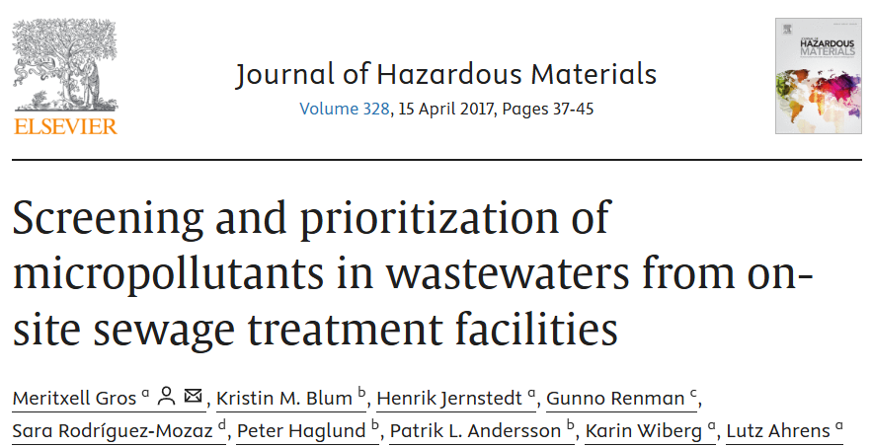
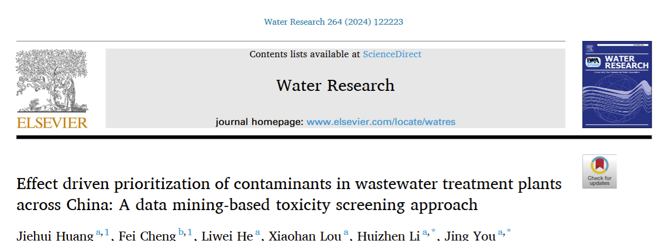
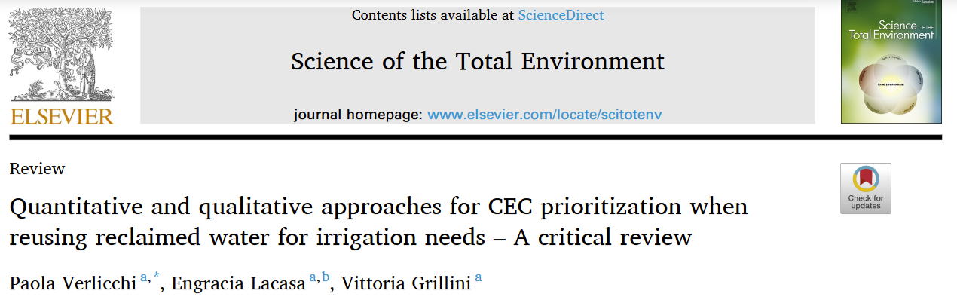
Task 1 - What to prioritize? Important compounds (POPs, heavy metals, CEC)
  Prioritization strategy based on ecotoxicity and models; exposure; bioactivity; selected groups of water contaminants; persistent and bioaccumulating compounds; removal efficiency; mobility; toxicity potential and frequency of detection.
Use of databases e.g., NORMAN EMPODAT database
- Collaborate with WG5 – Data and databases for REUSE
What about compounds not regulated?
Reference to mixture effects
Task leader and sub-leader
A total of 10,781 chemicals were reported in 8336 publications, of which 1037 contaminants were reported with environmental concentrations.
Detection frequency, concentration, removal efficiency, and toxicity data were integrated for assessing potential risks and prioritizing CECs on national and regional scales using an environmental health prioritization index (EHPi) approach.
A novel comprehensive prioritization strategy was then developed to identify OSSF specific chemicals of environmental relevance. The strategy was based on the compound concentrations in the wastewater, removal efficiency, frequency of detection in OSSFs and on in silico based data for toxicity, persistency and bioaccumulation potential.

Slide 3


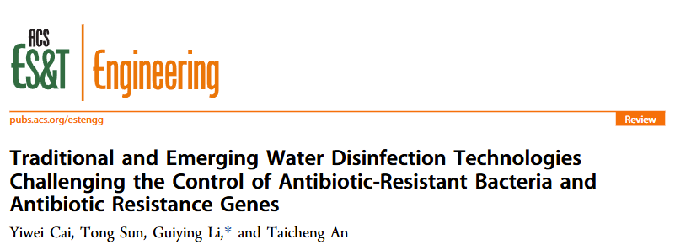
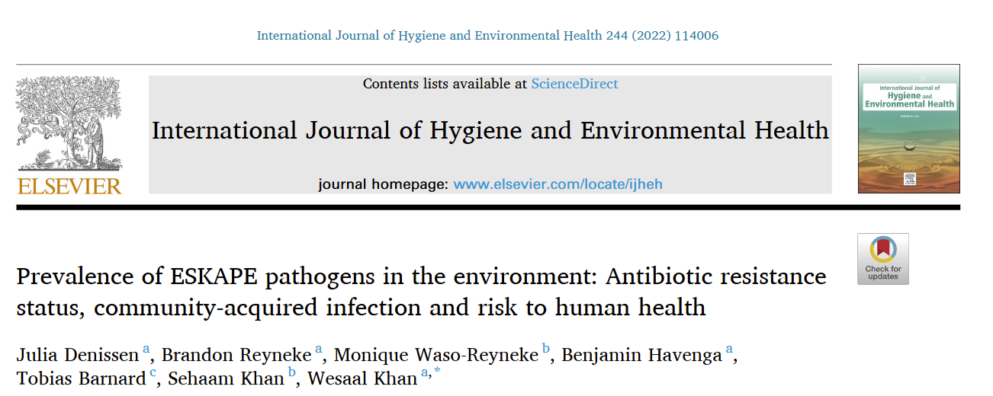
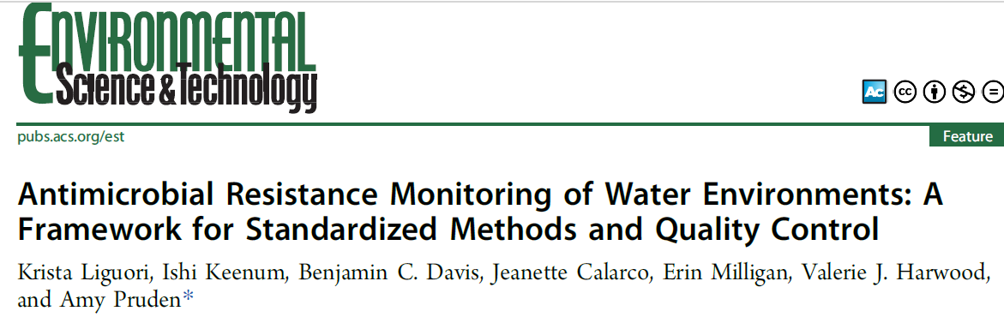
Task 2 - What about microbial contaminants?
Pathogens
ARB&ARGs
Microbial community structure
Very limited prioritization and risk assessment information available…
WG2 – Technologies
  Prioritization strategy based on:
  Pathogenicity;
  Exposure;
  Removal efficiency;
  Resistance to disinfection and regrowth;
  Frequency of detection;
  Accumulation following irrigation and biosolid amendment;
  Relevance to human health.
Decision making conclusion in collaboration with WG4 – digital sciences, modelling and decision making
Task leader and sub-leader

Slide 4

Routes of exposure within water reuse schemes of important contaminants within and beyond regulatory frameworks (reclaimed water, soil, crops, surface waters, groundwater, recovered resources)
Task leader and sub-leader
Chemical compounds
(POPs, heavy metals, CEC)
Microbial contaminants
Routes of exposure
Transport, transformation, fate processes
REUSE adverse effects
Routes of exposure
Transport, transformation, fate processes
REUSE adverse effects
Pathogens
ARB&ARGs
Microbial community structure
Use of databases e.g., NORMAN EMPODAT database
- Collaborate with WG5 – Data and databases for REUSE
Decision making conclusion in collaboration with WG4 – digital sciences, modelling and decision making

Slide 5
Identify responsible persons
Creation of Task Groups within WG3 and division of ‘labour’
3 Task leaders and co-leaders, that will also liaise with other WGs
Internal milestones
Engagement of young researchers
Online Task Group meetings – end of the month meetings?
Regular follow up e-mail communication.
Start of activity
Collection of literature
Preparation of review
A document will be circulated where you will be able to register your interest in contributing to the three Tasks.
As soon as all interest is registered, the first WG3 meeting will be held (end of February) to officially start working.

Slide 6
Expected deliverables of 2025
Review of the available data and prioritization of POPs and CEC in treated wastewater
Review of the available data and prioritization of microbial contaminants in treated wastewater
Review of routes of exposure within water reuse schemes of important contaminants within and beyond regulatory frameworks (reclaimed water, soil, crops, surface waters, groundwater, recovered resources)
Next steps… Years 2-3
1. Establishment of guidelines for performing quantitative microbial risk assessment to humans and to the environment, in line with existing frameworks.
2. How do we mitigate the problem?
→ Mitigation (centralized/decentralized technologies/multi-barrier approaches and their effectiveness)
Control solutions
Monitoring
…of contaminant diffusion in the environment
3. Risk management approaches and sustainable practices
4. Preparation of training events/courses/STSMs/VM

Slide 7
Next steps
Preparation of inventory of risk assessment/prioritization projects/PhDs etc.
What will be the basis of prioritization? Economic evaluation/treatment efficiency etc.?
To prepare a document of expression of interest of WG3 members.
Appointment of Task leaders in the next WG3 meeting (end of February).
To prepare an e-mail for WG3 to let members know of upcoming activities.
Explain the role of young researchers in the activities in the next meeting.
Start delegating with WG4 and WG5 for databases and decision making.

